Slide 1
Junior Parent Night
Class of 2023
Ms. Chavez
School Counselor

Slide 2
Welcome
About Me
  echavez38@dadeschools.net
Open Door Policy for Students, during lunch
Student requests on school website: Counselor Request Form
  https://www.gomakos.org/apps/forms2/?f=26882
Parent appointments: Available on SCOIR, 8:00 a.m. – 8:30 a.m.
Parent /Teacher Conferences

Slide 3
MAST Graduation Requirements
MAST Program Requirements
https://www.gomakos.org/pdf/MAST%20Academy%202000-2021%20CB%20Addendum.pdf
All need
  4 English credits: one college level English course required (ALL Senior year English fulfills this req.)
  4 total math credits: Pre-Calculus required
  5 credits of Science
  3 credits Social Studies
  2 credits of foreign language
  Personal Fitness* (@MAST they will complete in FLVS lab-9th grade)
  1 practical /fine arts credit
  FLVS Course* (@MAST they complete in 9th grade- Personal Fitness)
  Pass FSA ELA or concordant score SAT/ACT and Algebra 1 EOC or concordant score PSAT/SAT/ACT
Charting the Course
    Maritime: AS Marine Science, 1 additional college level science course (AS, A Level, AP, DE), AS Maritime History & Lit (AS General Paper), Maritime elective (senior year), Executive Internship, Swimming 1.
    CAMBRIDGE Global: 1 additional History course, AS Environmental Management , AS Global Perspectives & Independent Research, meet the foreign language requirements for bi-literacy seal, Swimming 1.
    CAMBRIDGE STEM: AS Environmental Management, one additional A level Science course, AS Global Perspectives & Independent Research, participation in a minimum of 1 approved STEM competition Experimental Science class. Approved list includes but is not limited to: Vex Robotics, Fairchild Challenge, SECME Olympiad, Mu Alpha Theta or District Science Fair, Swimming 1.

Slide 4
Graduation Requirements
Florida Department of Education
  https://www.gomakos.org/ourpages/auto/2019/7/30/48657509/1415a-forwardflyer.pdf?rnd=1564469528189
Grad TRACK https://dadeschools.eduvision.tv/directplayer.aspx?q=3SfVi13wT7Td7aEhU%252fcCHnfJBhsJkHGrh7orwU%252f0YSe5KH%252bzxzuOxw%253d%253d
Course histories reviewed a minimum of twice yearly by counselors
Review for any omissions, ex. FLVS course, dual enrollment or course from previous school

Slide 5
Community Service
100 hours
Non-profit organizations
Community Service Activity Log Form https://www.gomakos.org/ourpages/auto/2020/9/15/58454332/CS%20Form.pdf?rnd=1600206526278
Submit to counselor in Spring (or as soon as you have 100 hours or more)

Slide 6
GPA
4.0 scale
Weighted vs. Unweighted
Honors, AP, DE, AICE
Students GPA recalculates
  End of school year
  Beginning of school year
  Middle of School year (only includes term 1 classes ex. Swimming, Government, Personal Fitness)
** ONLY FINAL GRADES are calculated in GPA. 9 week grades are not on transcript, nor are they calculated into GPA after each grading period.

Slide 7
College Admissions Process
College List
Campus Tours/Visits, can be a pre-approved excused absence
SCOIR College Planning System
As a parent or guardian, you will be able to view their profiles, see their college list, conduct your own college searches, and suggest colleges for your student to consider. Scoir also provides parents with financial tools so that you can get a better sense of the cost of attendance at various colleges during the selection process.
  Invitations sent to students
  Student needs to invite parent (Under "My Profile")
  Student should complete their profile, "You Science" Career Assessment, and start researching colleges/College Search, set College preferences.
SCOIR Student Application Information Video https://vimeo.com/463477776
Florida Student Scholarships/Bright Futures
  https://www.floridastudentfinancialaidsg.org/SAPBFMAIN/SAPBFMAIN

Slide 8
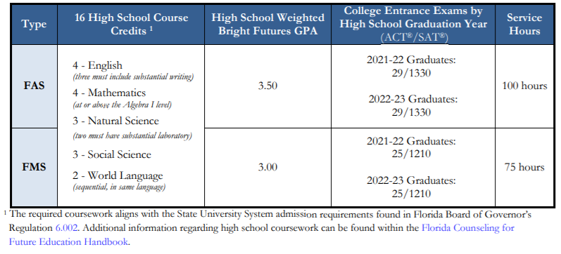
Bright Futures
Florida Academic Scholars/Florida medallion Scholars

Slide 9
SAT vs. ACT
SAT includes a Reading Test, Writing and Language Test, and a Math Test. The SAT has an optional essay component, which some colleges will require.
The ACT contains multiple choice tests in four areas: English, Mathematics, Reading, and Science. ACT’s writing test is optional and will not affect your composite score.
Test Format
Structure and Timing | SAT | ACT
Testing time | 3 hours + 50-minute essay (optional) | 2 hours 55 minutes + 40-minute essay (optional)
Structure | 3 tests + optional essay | 4 tests + optional writing test
Number of questions | 154 | 215
Time per question | 1 minute, 10 seconds | 49 seconds
Score range | Composite 400–1600 (SAT Essay: reported in 3 dimensions, each 2–8) | Composite 1–36 (writing domain scores: 2–12)
Test components | Reading Test 65 minutes 52 questions Writing and Language Test 35 minutes 44 questions Math Test 80 minutes 58 questions | Reading Test 35 minutes 40 questions English Test 45 minutes 75 questions Math Test 60 minutes 60 questions Science Test 35 minutes 40 questions

Slide 10
SAT: collegeboard.org
Register for SAT https://collegereadiness.collegeboard.org/sat
SAT Date | Registration deadline | Late Registration Deadline | Deadline for Changes
March 12, 2022 Register | February 11, 2022 | March 1, 2022 (for registrations made online or by phone) | March 1, 2022
May 7, 2022 Register | April 8, 2022 | April 26, 2022 (for registrations made online or by phone) | April 26, 2022
June 4, 2022 Register | May 5, 2022 | May 25, 2022 (for registrations made online or by phone) | May 25, 2022

Slide 11
ACT.org
Test Date | Regular Registration Deadline | Late Registration Deadline Late Fee Applies | Standby Deadline Photo Upload Deadline
February 12, 2022 | January 7 | January 21 | February 4
April 2, 2022 | February 25 | March 11 | March 25
June 11, 2022 | May 6 | May 20 | June 3
July 16, 2022 | June 17 | June 24 | July 8
2021-2022 Test Dates (National)

Slide 12
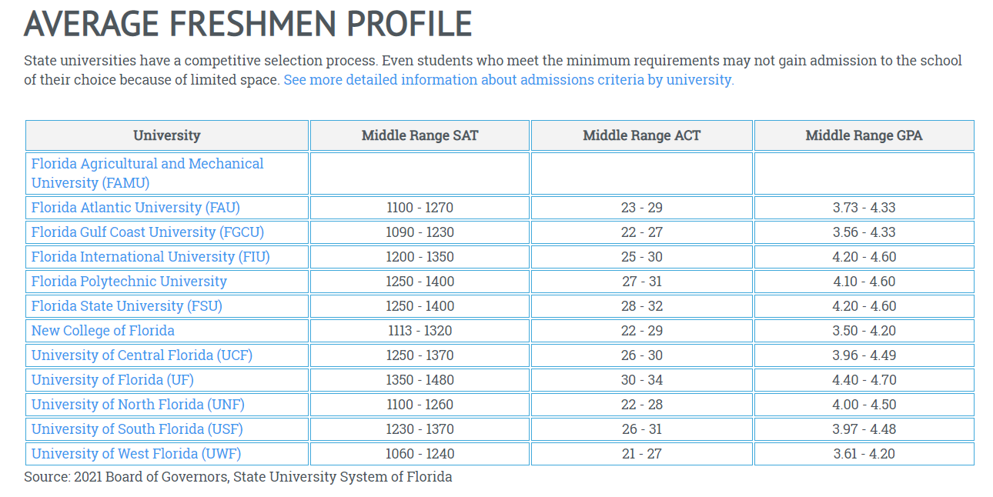
Florida Public Universities https://www.floridashines.org/go-to-college/get-ready-for-college/average-university-freshmen-profile

Slide 13
Q&A
Thank you!

