Slide 1
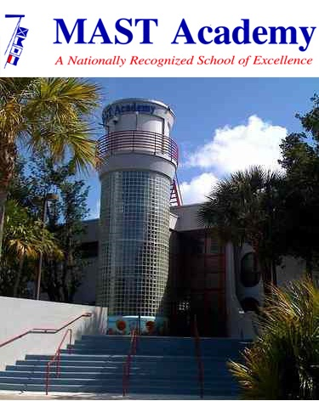
MAST ACADEMY
SUSTAINABILITY PLAN
Mission Statement: Establish and execute a 5 year sustainability plan, including net zero energy and net zero waste goals, incorporating conservation habits and new technology to save money, resources, and secure a livable world for our students.
Vision Statement: In the MAST tradition of environmental stewardship, we pledge personal responsibility to live within our means and promote the viable renewal of our treasured native land and marine species that have co-existed since Miami’s founding.
MAST Mission: Providing a marine setting and nurturing environment for studies leading to academic success, career preparation, and appreciation of the sea and environmental awareness.

Slide 2
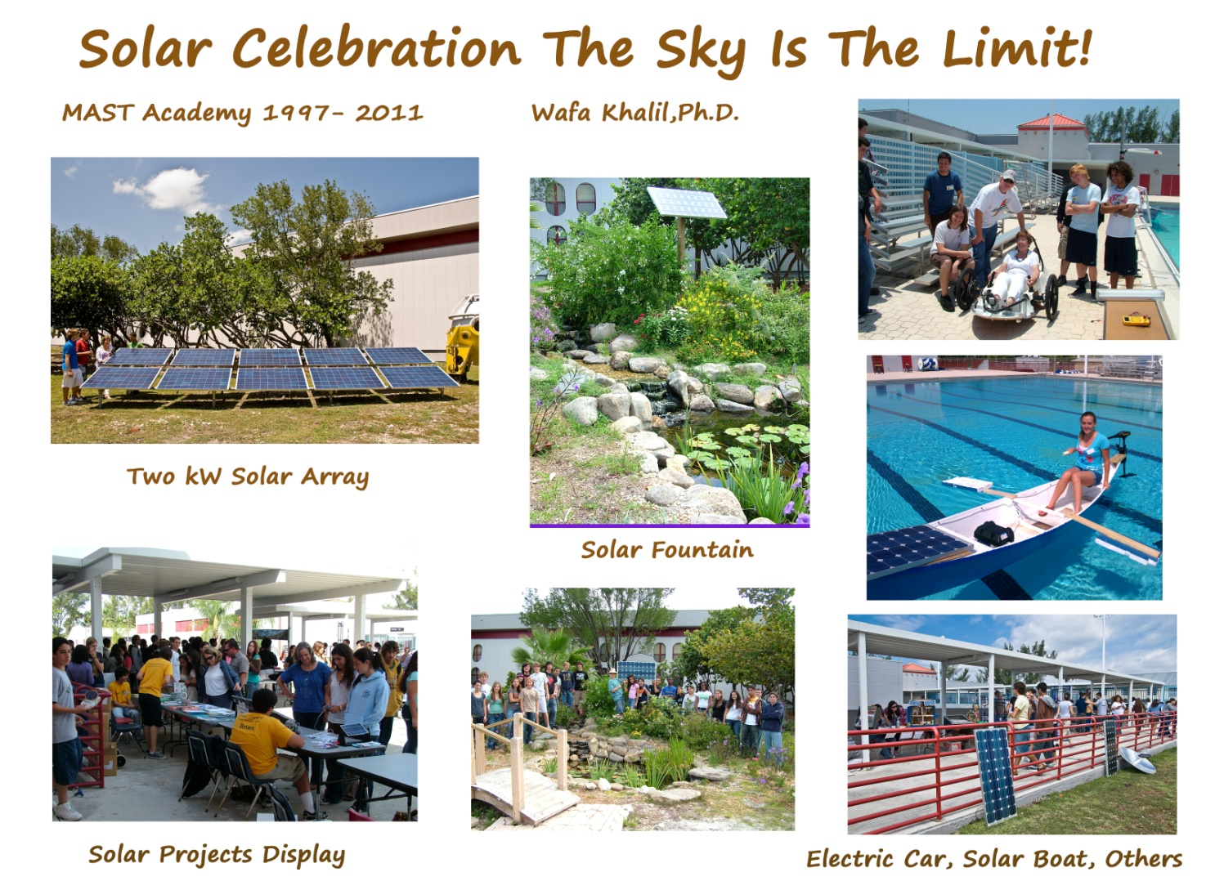
Why MAST? Tradition of Marine Stewardship and STEM.

Slide 3
MAST STUDENTS DRIVING THE CHANGE.
Delaney Reynolds addresses 1,000+ MAST students in January 2017.
They vote for a net zero energy school in five years!
Overheard by a 6th grader, “Can we sell lemonade to buy solar panels?”

Slide 4
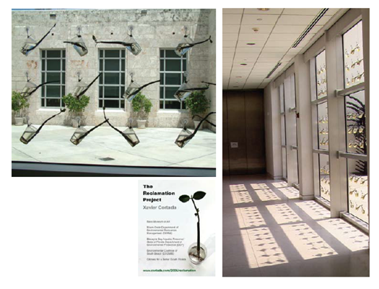


DOE: Green Ribbon Schools: III Pillars.
Reduced Environmental Impact and Costs: Pillar I
  Reduced greenhouse gas emissions, using an energy audit or emissions inventory and reduction plan, energy efficiency improvements, conservation measures, and/or renewable energy and/or purchase of green power;
  Improved water quality, efficiency, and conservation;
  Reduced solid waste production through increased recycling and composting
  Expanded use of alternative transportation, supportive projects and policies.
Improved Health and Wellness: Pillar II
  Coordinated school health, including health, nutrition, and outdoor physical education; health, counseling, and psychological services for both students and staff;
Effective Environmental and Sustainability Education: Pillar III
  Interdisciplinary learning about the key relationships between dynamic environmental, energy, and human systems;
  STEM content to prepare graduates for the 21st century technology-driven economy; and
  Student civic engagement to address sustainability issues in their community. (FROST SCIENCE MUVE AT MAST)

Slide 5
Green Ribbon Schools
Award Winning Districts in Florida:
  Palm Beach 2012-2013
  Broward 2013-2014
  Alachua 2015-2016
  Duval 2016-2017
Where’s Miami-Dade Distrct?
  Terra Schools 2011-2012
  Airbase K-8 2016-2017

Slide 6
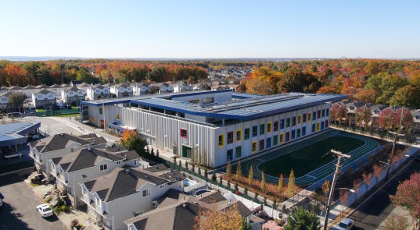
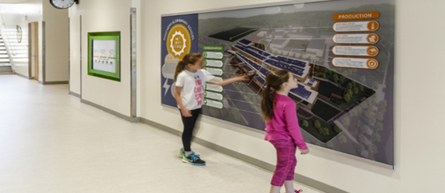
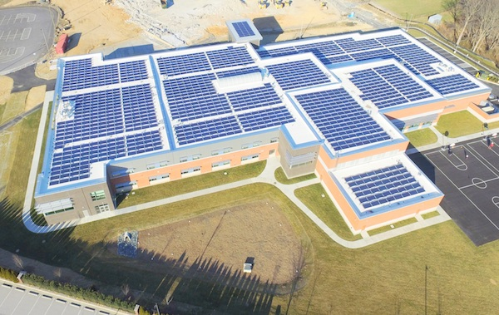
Net Zero Energy Schools DOE Program: California, Colorado, Maryland, New York, North Carolina, South Carolina, Virginia.
Called zero energy because they consume less energy or equal energy to the amount of power their renewable systems put on the grid, hence they produce energy savings for schools.
“By using the most energy-efficient technologies, and engaging students and the local community, school districts can lead the way in saving taxpayer dollars and creating more resilient and first-in-class educational facilities.”
Zero energy schools could save 65-to-80 percent in energy consumption = more money for students and teachers.
Schools are a good fit. Predictable and relatively constant energy demand, large roofs suitable for solar panels, and a long-term interest in reducing energy costs. Possess bonding authority for big projects.
Sustainable features also offer a teachable model for both the environment and technology. Can include nature-based motifs and energy dashboards and observable systems.

Slide 7
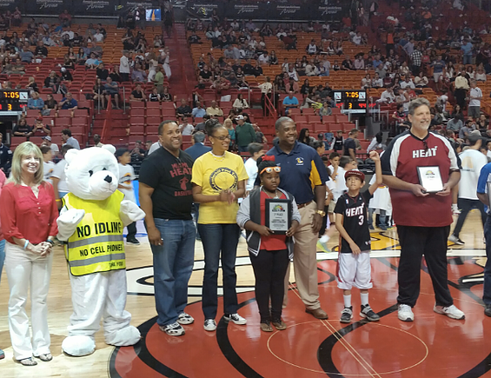


MIAMI HEAT’S
How Low Can You Go Challenge: Reversing CO2.
Broward, Miami-Dade, Palm Beach districts.
The Miami Heat will be sponsoring an exciting GRAND PRIZE that will include:
​
*Championship Banner and Plaque to the winning school, and a plaque for second and third place
* Recognition on the Miami Heat floor during the NBA Green Week
​

Slide 8
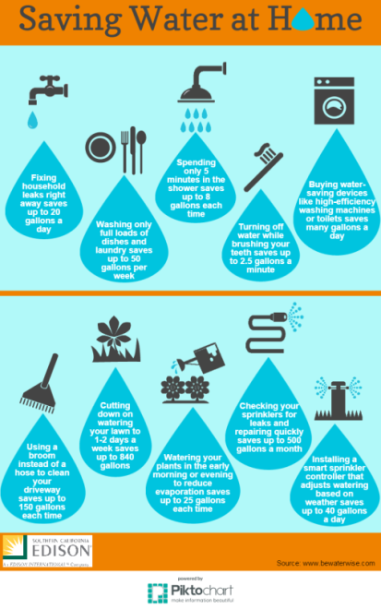

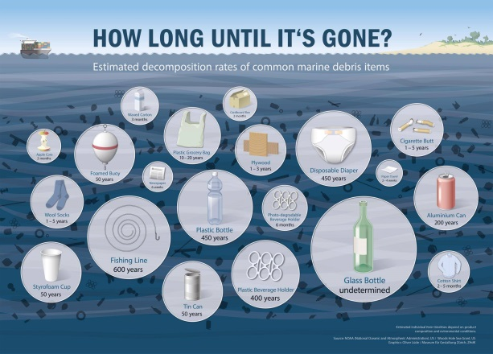


Slide 9
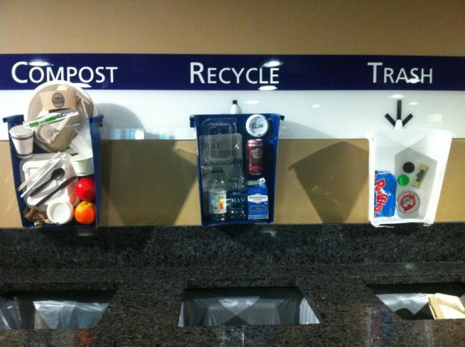


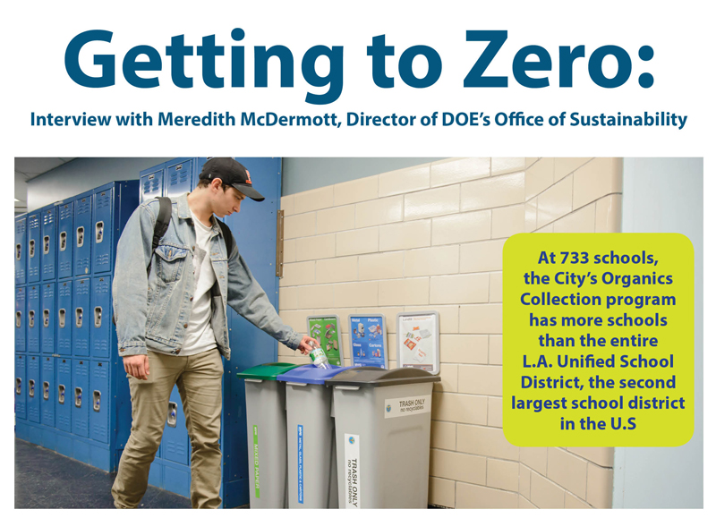
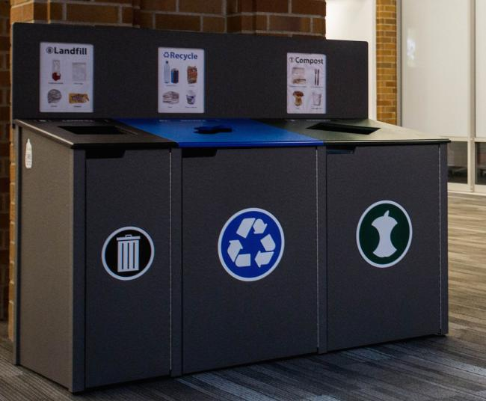
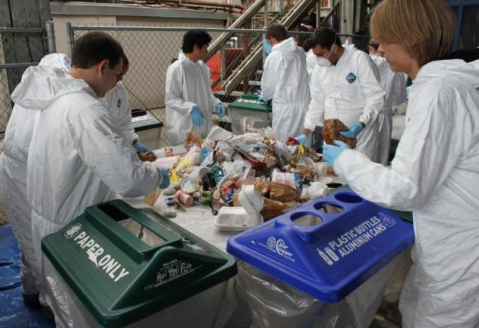
Zero Waste. NYC, LA (1st and 2nd largest Districts.)

Slide 10
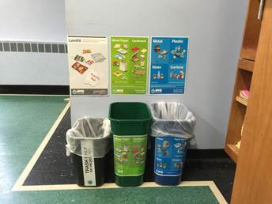
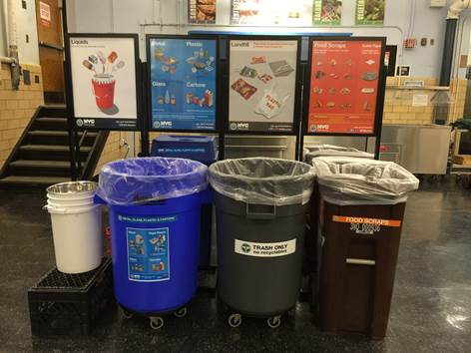
NYC ZERO WASTE SCHOOLS OVERVIEW:
Zero Waste Schools outfitted 100+ schools with full recycling setups for every classroom, common space (hallways, etc.) and sorting stations for the cafeterias.
4 WASTE STREAMS:
Paper/Cardboard,
Metal/Glass/Plastic/Carton, T
Trash (Landfill) and
Organics(Food Scrap/Solid Paper).
In addition to outfitting the Zero Waste Schools with bins/sorting stations, two outreach teams, one focused on education and one focused on operations, have been deployed to support the program on the ground.
Classroom Setups: 3, 10 gallon bins per classroom. One Trash Bin (black), one Paper/Cardboard bin (green), one Metal/Glass/Plastic/Carton bin (blue). Cost/bin= approx. $6 ($18/classroom) X 40 = $864.
Common Area Setups: 3, 23 gallon bins, with lids.
Cost/set up: $230 x 10 = $2,300.
Cafeteria sorting stations: 7 gallon liquid pour bucket, metal colander, Metal/Glass/Plastic/Carton 44 gallon bin (blue), Trash bin 44 gallon (gray), Organics bin (brown)- rodent proof for curbside set out, 4 sign stands.
Cost/station: approx. $350 x 2 = $700.
Compost and recycling set up and consult: $910 + $4,014 + $9,050 = $13,974

Slide 11

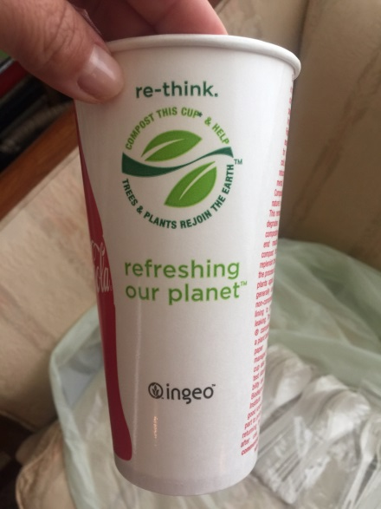
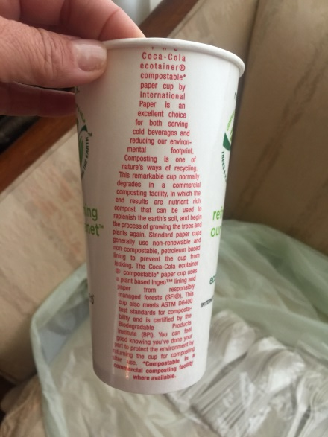
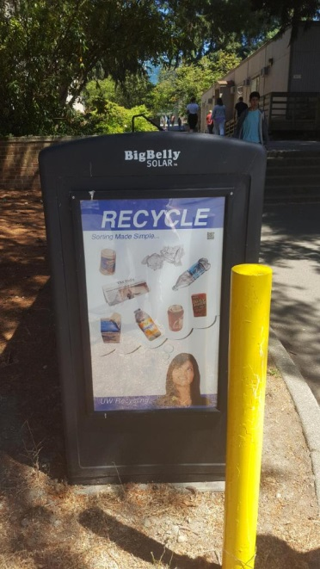
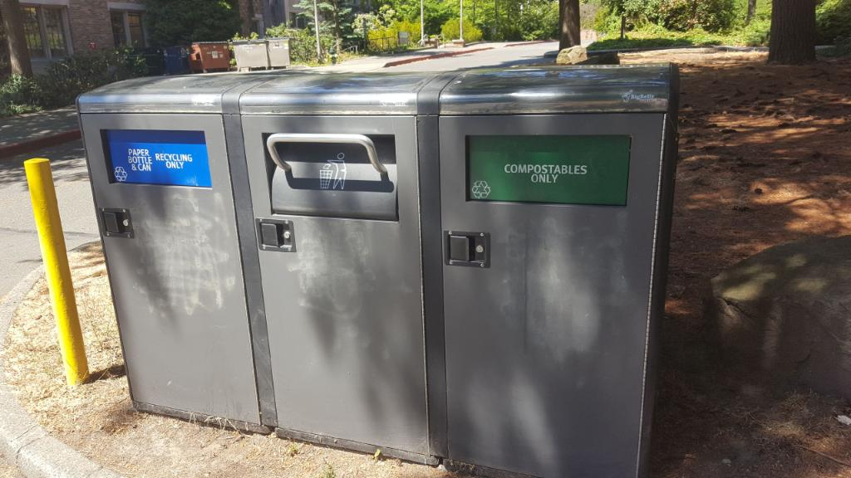
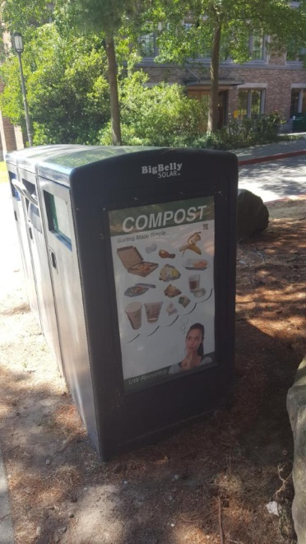

Slide 12
The Ridan is a manual in-vessel composter. As food waste is introduced at one end and the handle is rotated, oxygen aerates the mass heating up while traveling through the Ridan. During three composting stages, different microorganisms digest food waste and woodchips, transforming into compost before automatically emerging from the outlet at the other end.
Large model + three maturation bins (1) $8,650 Medium model + two maturation bins (1) $6,400
Shipping (2) $400
Dramatically reduces food scraps disposal costs.
Reduces transportation costs and carbon dioxide emissions (CO2).
Immediate treatment eradicates vermin problems and pest control costs.
Eliminates trash-related odors.
Eliminates the need for garbage bags to dispose of food scraps.
Medium Ridan 52 52 132 7.8 x 3.6 x 5.3 Ridan handle V2 2
Large Ridan 105 105 155 8.2 x 4 x 5.6 Ridan handle V2 3
Maturation Bins (2) 240 40 x 40 x 40

Slide 13

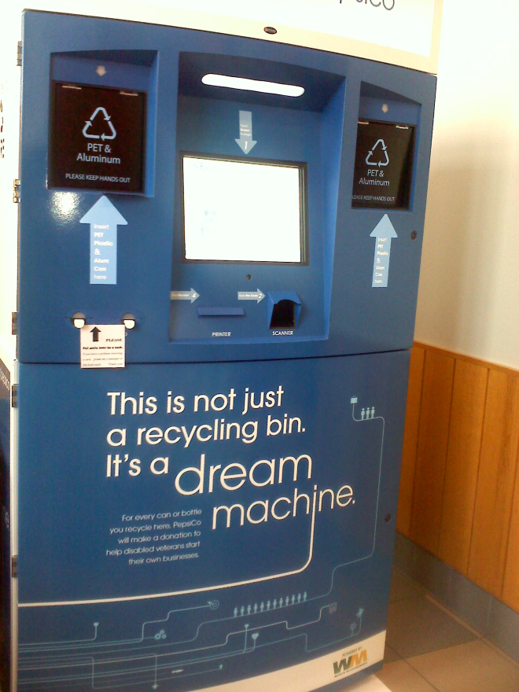


Get ready to rally! Recycle Rally is a free nationwide program that directly benefits K-12 schools and students by providing valuable incentives and resources to help make recycling easy, fun, and rewarding.
#26 Mater Academy Middle & High School Hialeah Gardens, FL
26,522 cans and bottles
Accumulate reward points in your online account and redeem them for recycling bins, supplies, and other goodies to keep your recycling teams going strong.

Slide 14
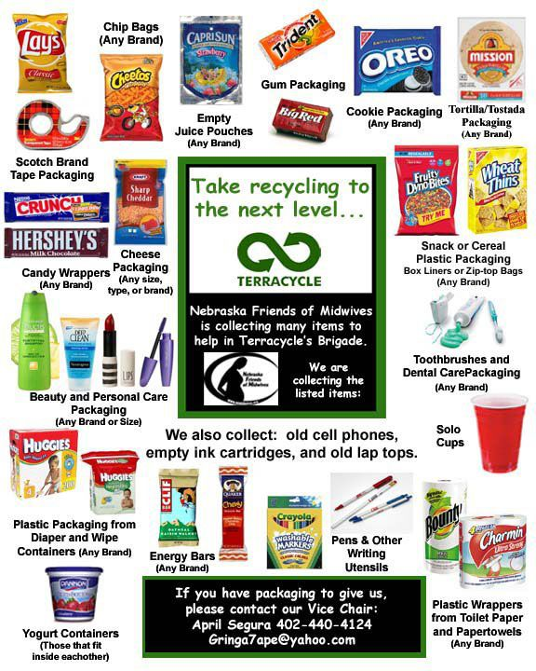
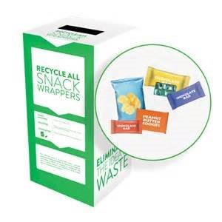
Terracycle for hard to recycle items: $85/box X 6 = $510. Free items too.

Slide 15

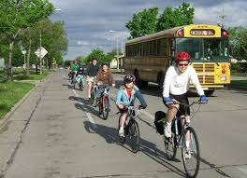
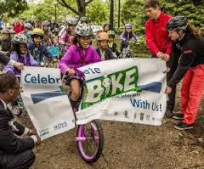
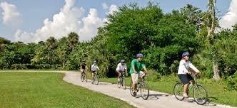
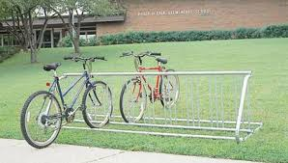
Parent/Student Bike Train. Bike305
SafeBikeUM.

Slide 16
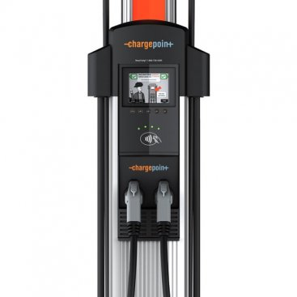
Car Charging at MAST.
ChargePoint Afloat Program. $100/month per parking space. School pays install and electricity ($45/month), but unit is free and maintained by chargpoint. No compete for 7 years.
EV install will increase EV parking six fold when installed. No EV units in Key Biscayne.
Note: Jax School District has a program where staff can trickle charge at school for $10/month. BYOC(charger).

